Slide 1

Sales Analysis
Vrinda store

Slide 2
Objective
First objective is to create annual sales analysis report of Vrinda store and find out the insights
Find out the insights of annual year 2022
so that easily predict the what necessary steps will taken for the better sales of Vrinda store in 2023

Slide 3
Agenda :-
Compare the sales and orders using a single chart
Which month got the highest sales and orders?
Who purchased more- men or women in 2022?
What are the different order status in 2022?
List the top 10 states contributing to the sales.
Relation between age and gender based on number?
Which channel is contributing to maximum sales?
Highest selling category?

Slide 4
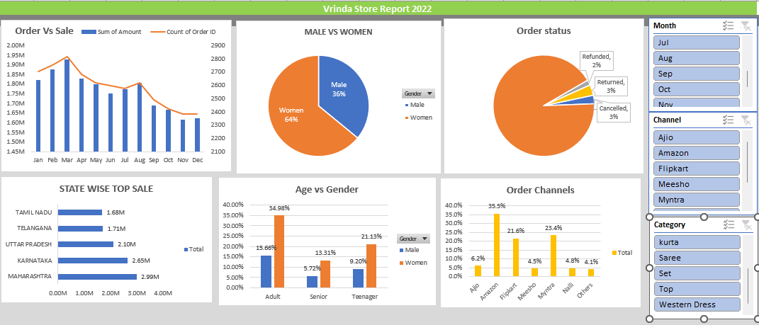

Slide 5
Conclusion:-
The March month contributed the major sales
Women are purchasing more as compared to males
Around 90% of orders happened in the year 2022 and very less amount returned (8%), cancelled (6%), and replaced(3%).
Major contributing states are the Maharashtra
The age group of women adult group contributed to the major sales.
Amazon is the major channel for the shopping.
Women’s top is the major selling category among all other products.

